Slide 1
CoE Circular Economy
September 2024

Slide 2


Standard Services
CoE Circular Economy

Slide 3
1
Our goals

Slide 4
Support our clients to set and achieve ESG goals.
Develop innovative solutions for the implementation of circular and sustainable models.
Influence the society and market to adopt and encourage regenerative practices and models.

Slide 5
2
Area of ​​activity

Slide 6








PIC – Product Innovation Center
Consultacy
A NEW WAY TO ACCELERATE THE MATURITY OF GREAT IDEAS.
Working on global projects and products, FIT professionals have unique experience in what it takes to transform an idea into a successful product. From best design practices, such as design for environment and design for manufacturing, to assistance with the certifications required for products to go to market.
SOLUTIONS THAT ADAPT TO MARKET NEEDS.
FIT's consulting services are aimed at large companies that believe that technology can generate competitiveness with sustainability. Disruptive technologies without forgetting the basics, this is how FIT helps its clients.
(IN INDUSTRY 4.0 ; THE CIRCULAR ECONOMY ; ENVIRONMENT ; SOCIETY).
R&D
Training
WE HAVE A STRUCTURE DESIGNED TO MEET THE R&D DEMAND OF COMPANIES THAT WORK IN DIFFERENT SEGMENTS, ANYWHERE IN THE WORLD!
01. Lei da Informática;
02. Lei do Bem;
03. Programa de Pesquisa e Desenvolvimento e Inovação (PROPDI);
4. Mover.
BRAZILIAN DIGITAL TRANSFORMATION
Sharing knowledge is what enables joint improvement and guidance towards the best path.
The "MCTI Futuro: Future of Work, Work of the Future" Program, focused on supporting actions that aim to expand the number of professionals to work in digital ecosystems, in digital transformation and research, development and innovation (RD&I) projects, and that, additionally, contribute to qualifying people in high-demand professions in the field of Information and Communication Technologies (ICTs).
FIT is one of the ICTs participating in this program together with MCTI and Softex, offering training for Educational Institutions, companies and society in general in the professions of the future.
Consultacy
R&D
Consultacy
R&D

Slide 7
3
Our team

Slide 8

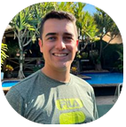
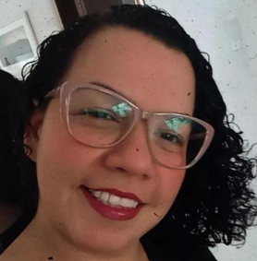
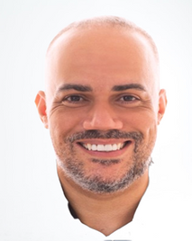
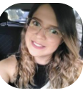
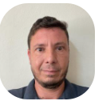
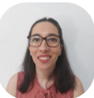
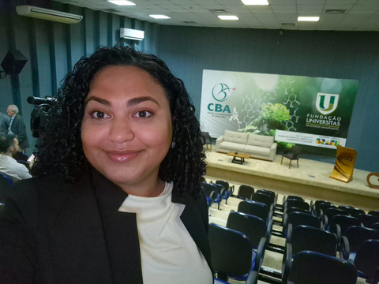
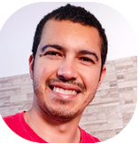
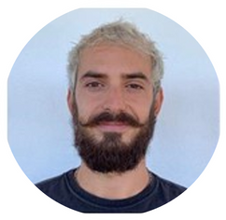
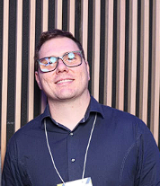
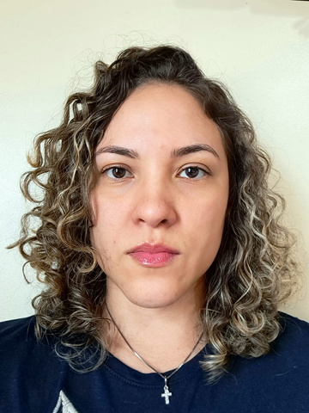
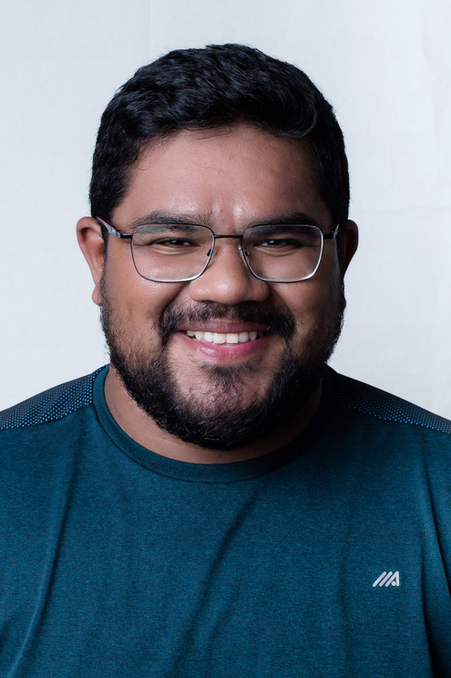
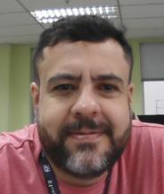
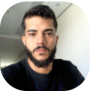
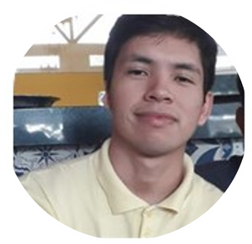
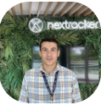
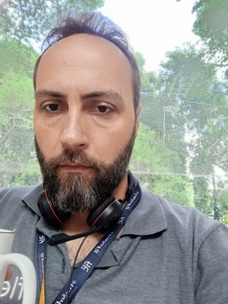

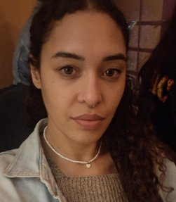
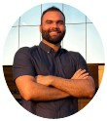
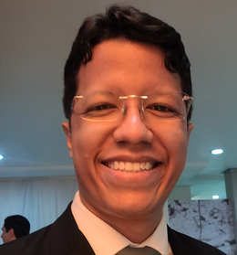
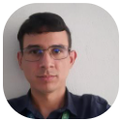
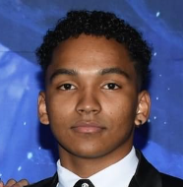
CoE Circular Economy
Technical leader
JOSUÉ GRATON
Specialist – Sustainability & CE
Research
Dra. ISABEL DINÓLA
Dr. HENRIQUE MARANDUBA
Dra. MILENA SOUZA
Dr. RICARDO CASTRO
Dra. EFIGENIA ROSSI
Dra. VANESSA MEIRELES
Engineer
MAURICIO DE PAULA
Packaging
RENAN RUFFO
Environmental
GUILHERME ZEPONI
Environmental
ELINE AGUIAR
Environmental
WILLIAMS COSTA
Mechanical
FERNANDO JUNIOR
Electrical
SILAS FERNANDES
Automation
KELYSON ANJOS
Assistant
GABRIEL SISTERNA
Assistant
www.fit-tecnologia.org.br
Intern
www.fit-tecnologia.org.br
Software
FRANCISCO RODRIGUES
PAULO DOURADO
SABRINA LUCIANA
MICHEL MATOS
HUMBERTO JUNIOR
ADAILTON SILVA
DIEGO SANTOS
Intern
Notes:
TBH – Estagiario
8

Slide 9
4
Our Know-How

Slide 10
ESG
Life Cycle Assessment
D4CE of Packaging
Capabilities CoE
D4CE of Products
R&D of New Materials
Digital Platforms
Renewable Energy

Slide 11

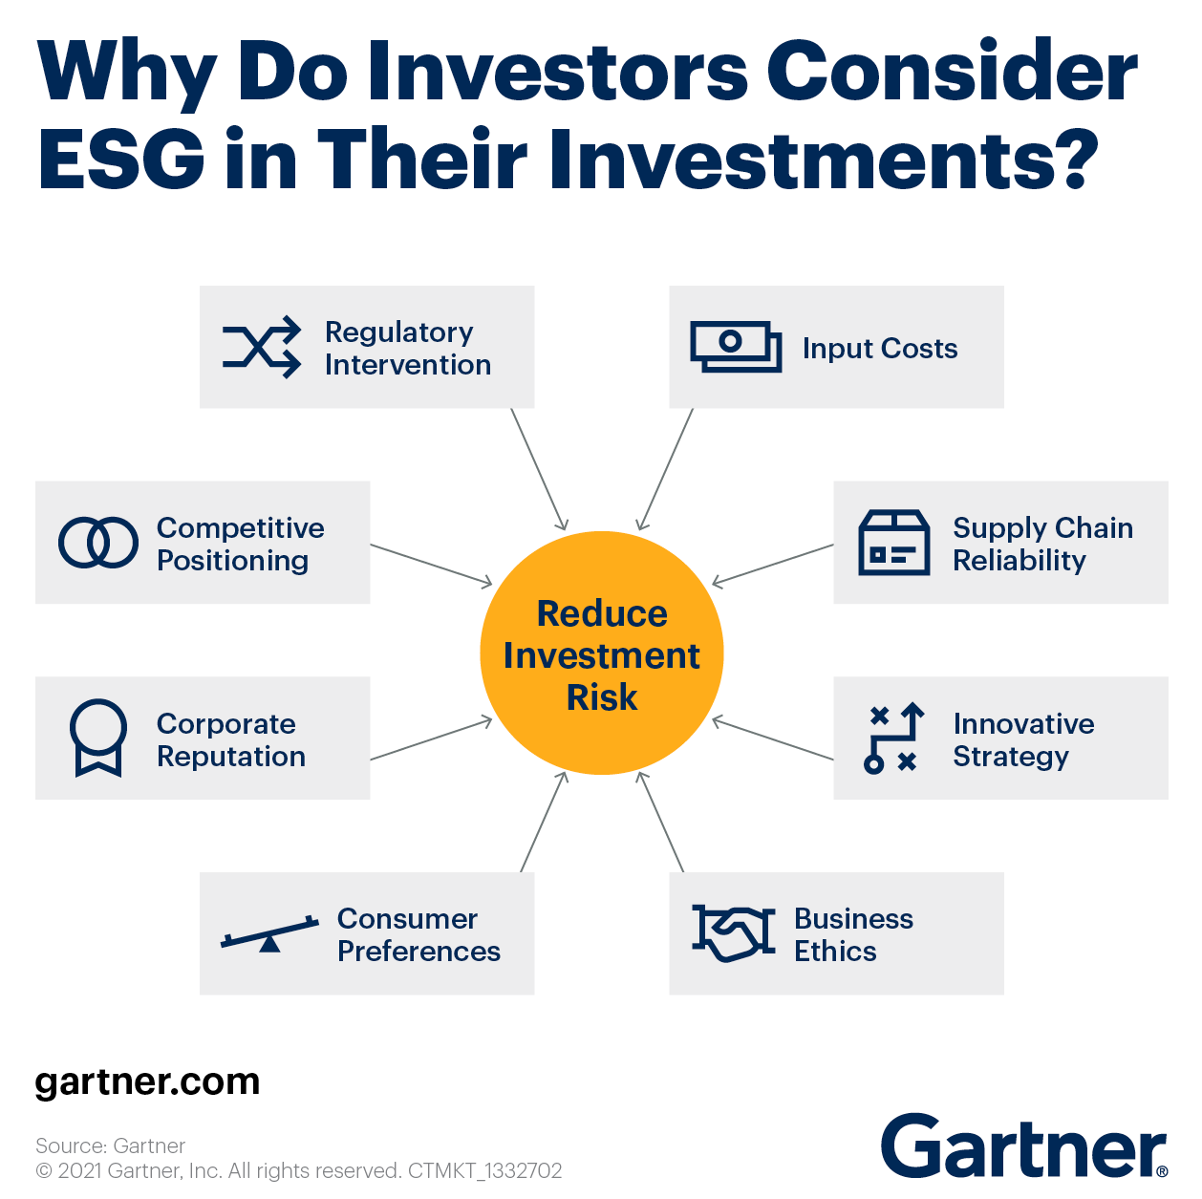




ESG
ABNT PR2030/ ABNT PR2060;
GHG Inventories (Greenhouse Gases);
Certifications / Self-declarations;
ESG assessments;
Environmental Credits;
Training.

Slide 12



Life Cycle Assessment
ABNT NBR:ISO 14040/ NBR:ISO 14044;
Mapping of primary data;
Scenarios definition;
Secondary databases;
Life Cycle Inventories;
Life Cycle Impact Assessment;
Certifications / Self-declarations.
Softwares

Slide 13






D4CE of Packaging
Reduce
Rethink
Redraw
Design for Circular Economy of packaging/ CAD designs;
Packaging prototyping;
Test management for packaging qualification;
Smart Packaging (User experience, security, credibility, traceability etc.);
LCA according scenarios definition.
Softwares

Slide 14

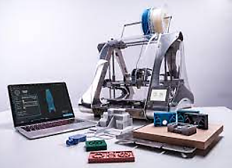

D4CE of Products
Design for Circular Economy of electronic products;
Prototyping of electronic products;
Test management for product qualification;
LCA according scenarios definition.

Slide 15
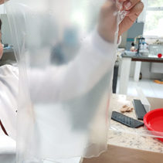
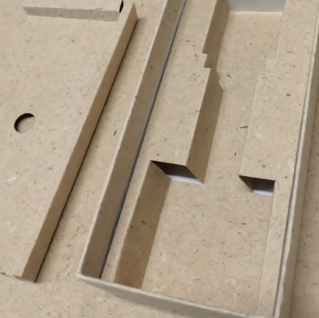
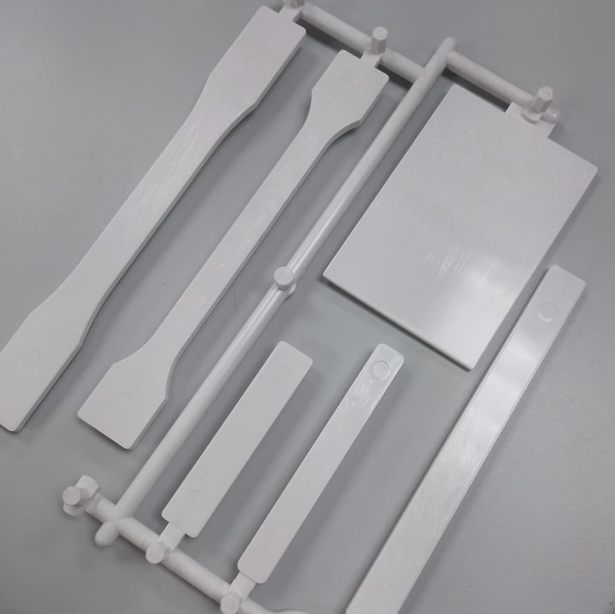
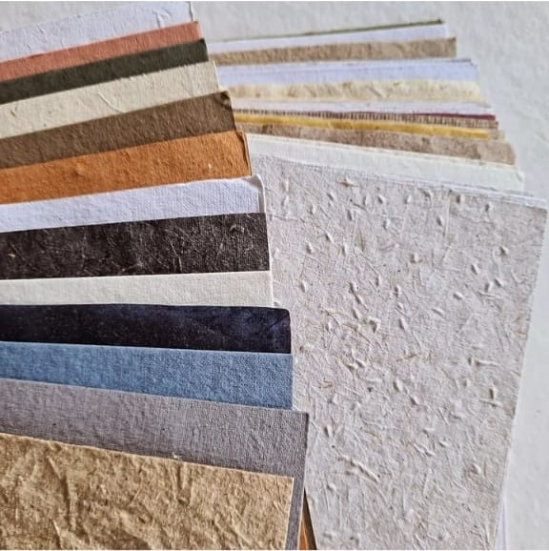
R&D of New Materials
Bibliographic research of biomaterials;
Development of specimens;
Management of laboratory tests for biomaterials qualification.

Slide 16
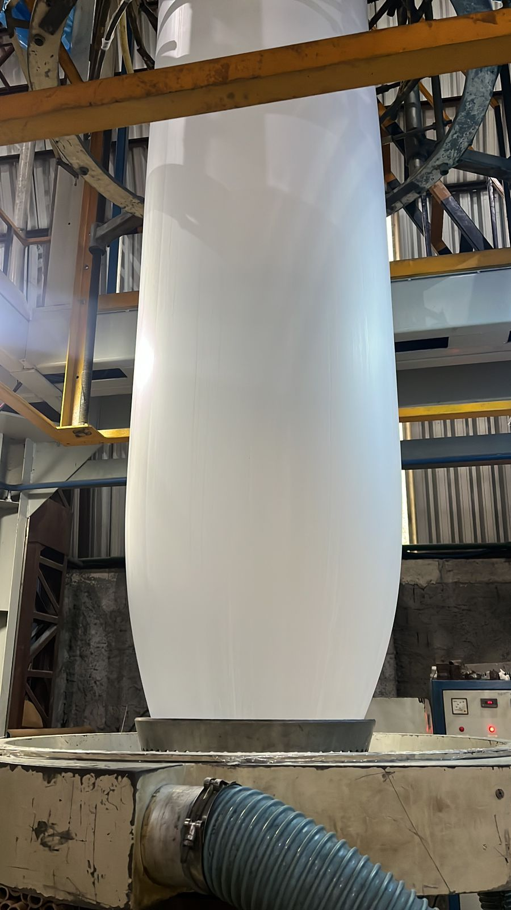
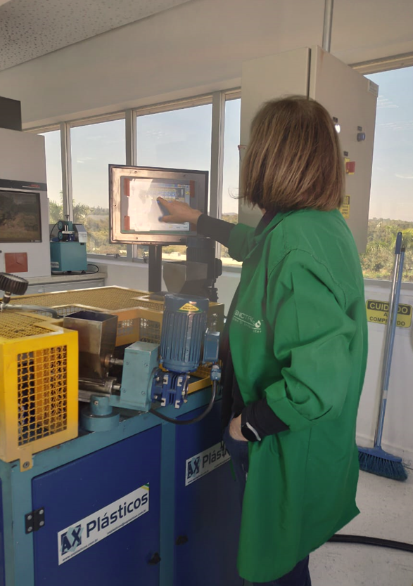
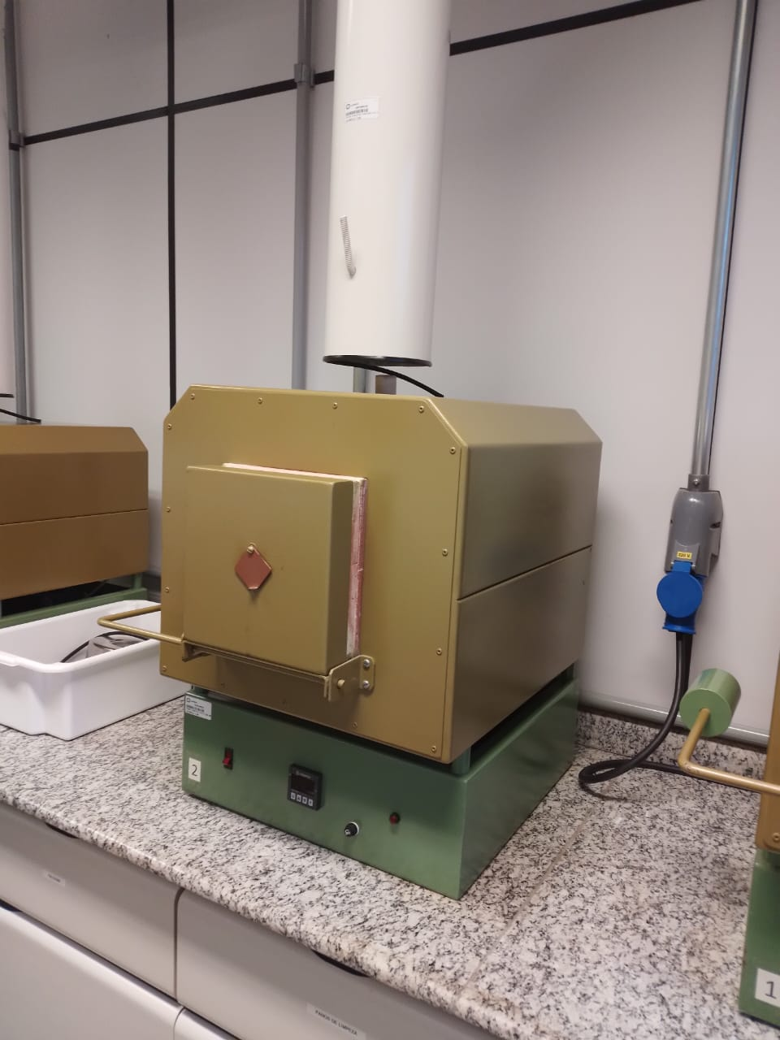
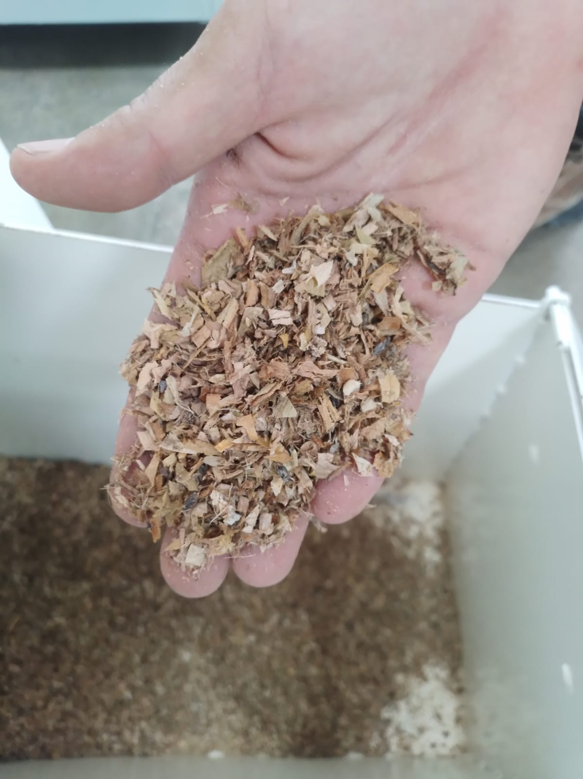
Technical Capacity
​Selection of raw material;​
Development of compounds;​
Manufacture of test specimens;
Mechanical and thermal characterizations;
Production of Prototypes.

Slide 17
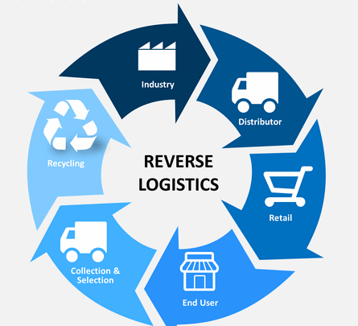

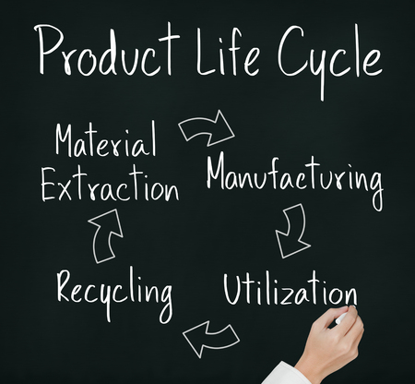

Digital Platforms
Reverse Logistics;
Secondary material sales;
Life cycle extension;
ESG management;
IOT services;
Industry 4.0.

Slide 18


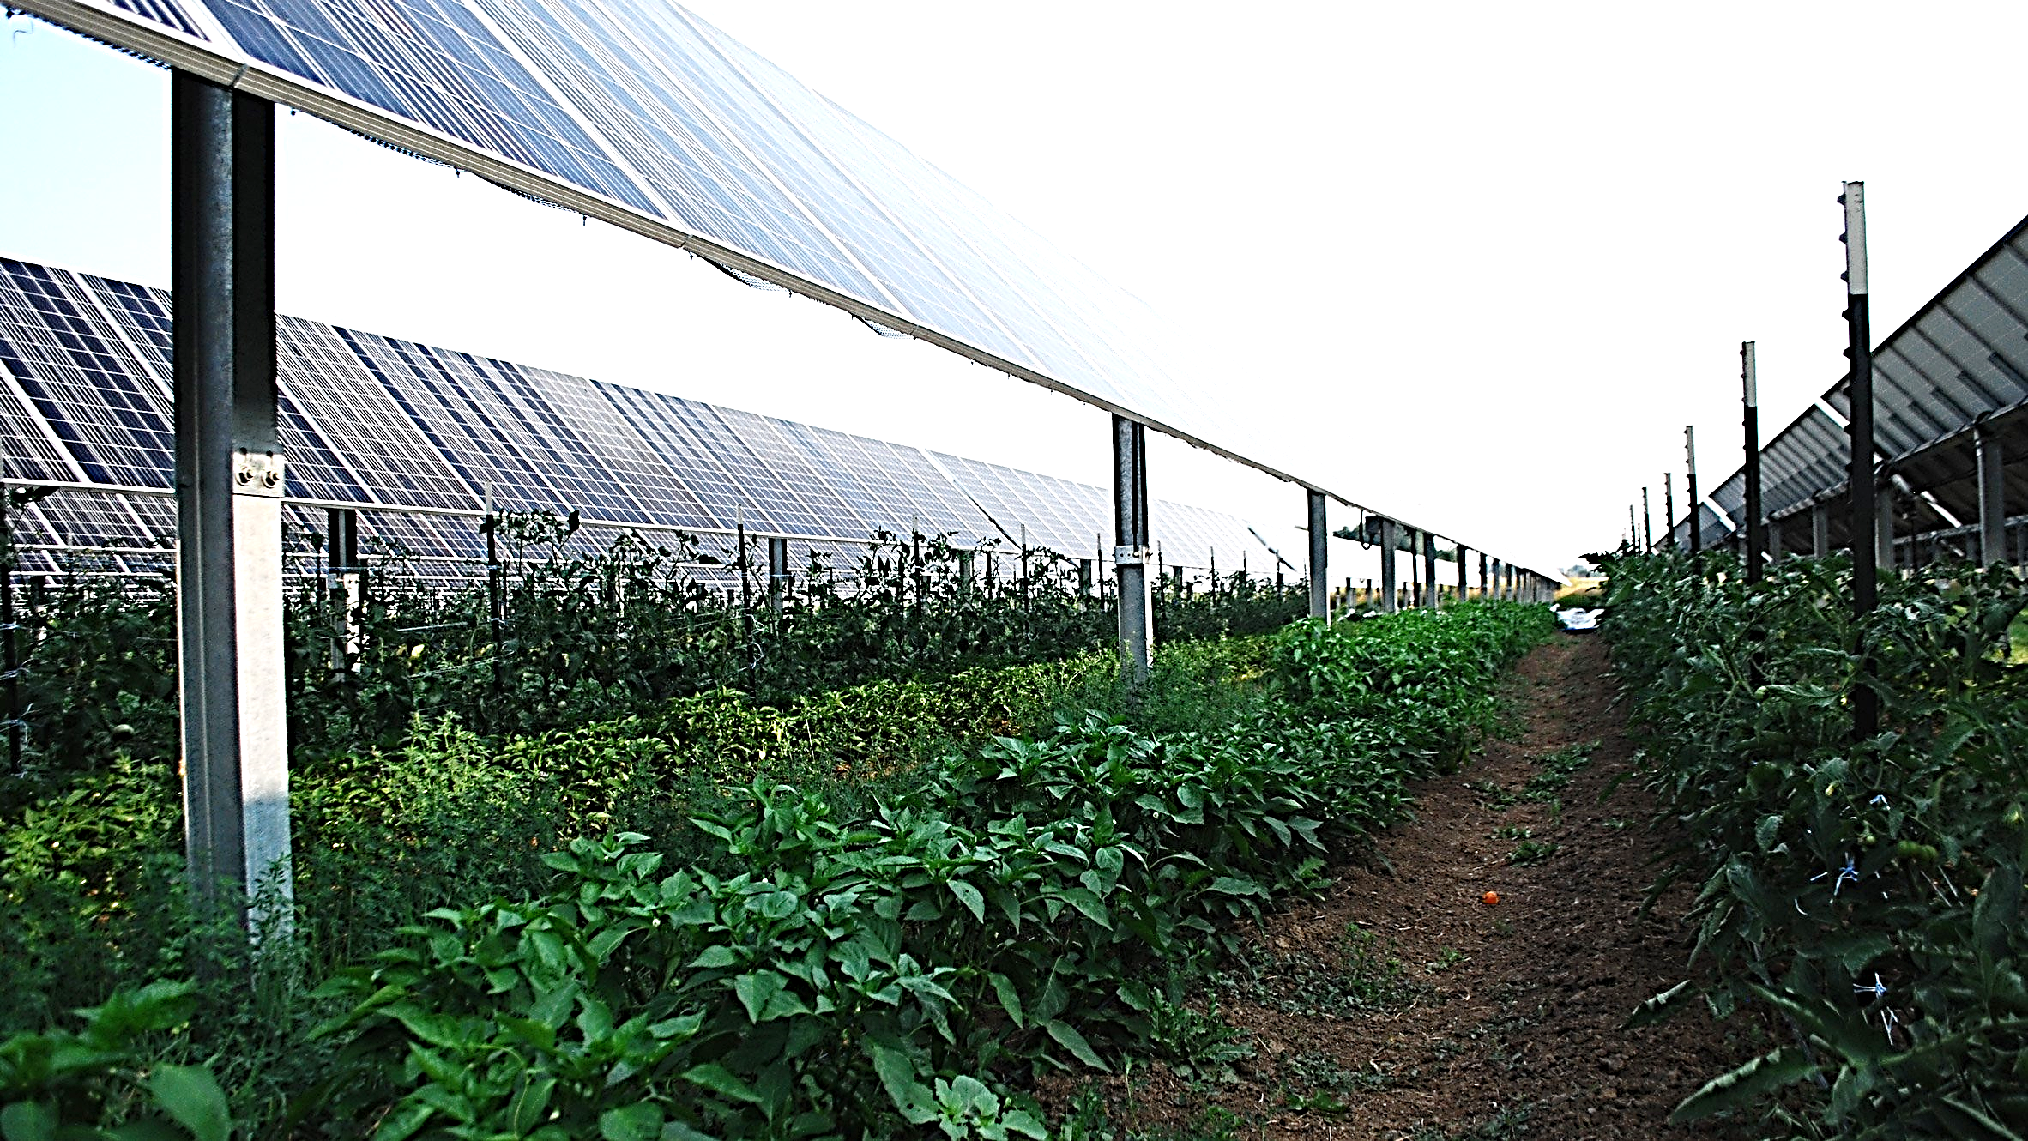
Renewable Energy
Carbon footprint analysis;
Agri-voltaic projects.

Slide 19
5
Our Partners

Slide 20
















Slide 21

Thank you!
josue.graton@fit-tecnologia.org.br
Notes:
Deixar a apresentação + Fluida e contando uma história

